Slide 1
Coptic Lesson 13
Definite & Indefinite Articles

Slide 2
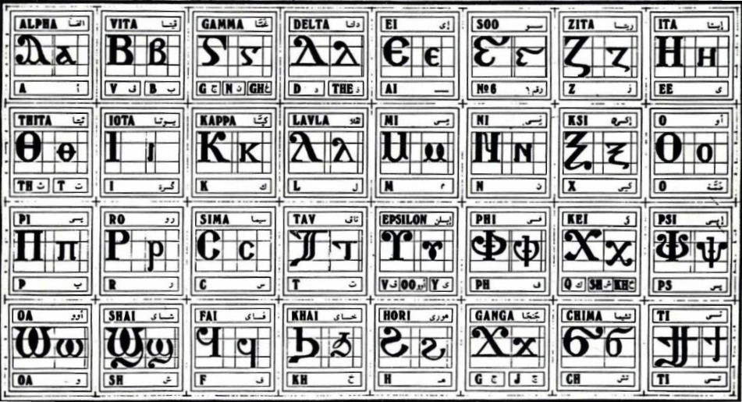
Coptic Alphabets

Slide 3
Review Questions
Coptic
Name
English
'
Epsee
ps
q
Khai
kh
=m=y
`hme-`smyn
48
=ia
Myt-ouai
11
g
Ghamma
gh, g, n
===;=c
:eoc
God (Gk)
=t=k
Somt-se-jout
320

Slide 4
Rule for the Iota i:
e
(if 1st letter in a word)
ee
I i =
(between consonants)
y
(next to a vowel)
Examples:
isi
rwmi
iom
Icrayl
niben
Ic,uroc
nai
`agioc
`<rictoc
`ilewc
Mari`a

Slide 5
Coptic Bible Verses
Anok pe piAlva nem piW ]ar,y nem pijwk ebol. "I am the Alpha and the Omega, the Beginning and the End." (Rev 1:8)
Anok pe piwik `nte `pwnq. "I am the Bread of life." (Jn 6:35)
Anok pe `vouwini `mpikocmoc. "I am the light of the world." (Jn 8:12)
Matai `epekiwt nem tekmau. "Honor your father and your mother." (Eph 6:2)

Slide 6
Vocabulary List
iwt
Father
rwmi
man
ouwini
light
mau
mother
Nou]
God
jwm
book
syri
son

Slide 7
Indefinite Articles
ou = a, an
oujwm = a book
oumolh = a candle
outotc = a chair
oukas = a pencil
ouws = a lesson
ou`ajp = a watch
han = s, some
hanjwm = books
hanmolh = candles
hantotc = chairs
hankas = pencils
hanws = lessons
han`ajp = watches
Practice using the following nouns:
rwmi
cwni
mau
nyb
jij
sau
ouro
bal
vorsi
`ajp
totc

Slide 8
Indefinite Article Exercise (Part 1)
Word
Singular
Plural
`alou
ou`alou
Han`alou
con
oucon
hancon
ran
ouran
hanran
iwt
ouiwt
haniwt
soury
ousoury
hansoury
ri
ouri
hanri
ve
ouve
hanve

Slide 9
Definite Articles
pi> `p> `v _ the (singular masculine)
`v if the word starts with b> i> l> m> n> ou> r
Examples:
piromi pikahi `Vnou] pi`alou piioh
`vry picon `psyri ``viwt pibal
`pyi `vran piro `pouro `vnyb

Slide 10
Definite Articles
]> `t> `; _ the (singular feminine)
`; if the word starts with b> i> l> m> n> ou> r
Examples:
]`chimi ]vorsi `tseri ]ourw ]ri
]cwni ]ajp `tve ]sau ]soury
`;mau ]`alou ]jij `;nyb ]hiomi

Slide 11
Definite Articles
ni- _ the (plural)
Examples:
nicwni nirwmi niran nimau ni`alou
nijom niourw nibal nisau ninyb
niseri nitotc niio] niourwou nivyou`i

Slide 12
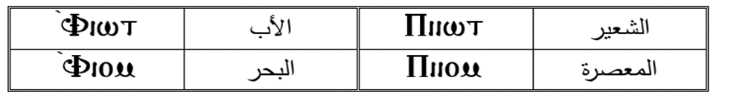
General Definite Articles
Pi ] ni
General and specific definite articles are used to give different meaning to the same word.
Examples:
`Viwt _ the father
`Viom _ the sea
Piiwt _ the barely
Piiom _ the press

Slide 13
Exercise (Part 1)
Translate the following into English:
Pirwmi nem ]`chimi
The man and the woman
Picon nem ]cwni
The brother and the sister
Pi`alou nem ]`alou
The boy and the girl
`Viwt nem `;mau
The father and the mother
`Tve nem pikahi
The sky and the earth
`Pyi nem ]ri
The house and the room

Slide 14
Exercise (Part 2)
Translate the following into Coptic:
The room and the door
]ri nem piro
The table and the chair
}vorsi nem pitotc
The brothers and the sisters
Ni`cnyou nem nicwni
The fathers and the mothers
Niio] nem nimau
The women and the men
Nihiomi nem nirwmi
The boys and the girls
Ni`alwou`i nem niseri
The kings and the queens
Niourwou nem niourw

Slide 15
Announcement
All slides are available at http://www.ekladious.com/coptic.html

Slide 16

Oujai qen `P[oic

